Slide 1
Machine Learning Lab

Slide 2
Python Introduction in MSTC GitHub
https://github.com/MasterMSTC/Python/

Slide 3
What is Python?
Python is a widely used general-purpose, high level programming language.
It was initially designed by Guido van Rossum in 1991 and developed by Python Software Foundation.
It was mainly developed for emphasis on code readability, and its syntax allows programmers to express concepts in fewer lines of code.
Python is a programming language that lets you work quickly and integrate systems more efficiently.
There are two major Python versions- Python 2 and Python 3. Both are quite different.

Slide 4
What is Python?
Python Software Foundation
https://www.python.org/doc/essays/blurb/
Python is an interpreted, object-oriented, high-level programming language with dynamic semantics.
… very attractive for Rapid Application Development, as well as for use as a scripting or glue language to connect existing components together.
Python's simple, easy to learn syntax emphasizes readability and therefore reduces the cost of program maintenance.
Python supports modules and packages, which encourages program modularity and code reuse. https://pypi.org/

Slide 5
Python Introduction
The language and its use: shell, script, program
https://campus.datacamp.com/courses/intro-to-python-for-data-science/chapter-1-python-basics?ex=6
Using Shell:
Operations and print
Variables: weight, height, BMI
Using .py script (test1.py)
Read input arguments
Write file
Read file (Configuration file : yaml, json,..)

Slide 6
Command Line: open Python shell
C:\Users\usuario\AppData\Local
Prompt (“>>>”): in the shell, waiting for a command
Operations depend on datatypes
3 + 5 vs ‘ab’ + ‘def’

Slide 7
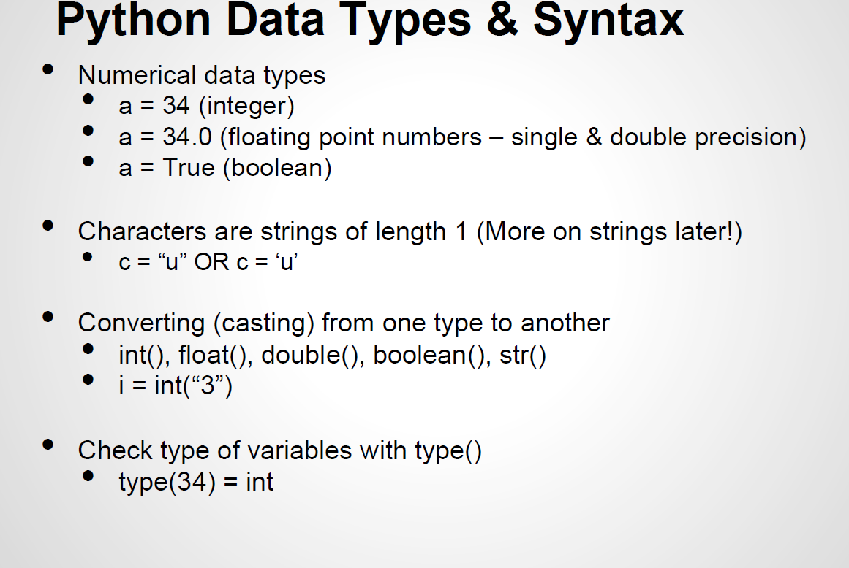
https://www2.cs.duke.edu/courses/fall14/compsci260/resources/python.tutorial.1.2014.pdf

Slide 8
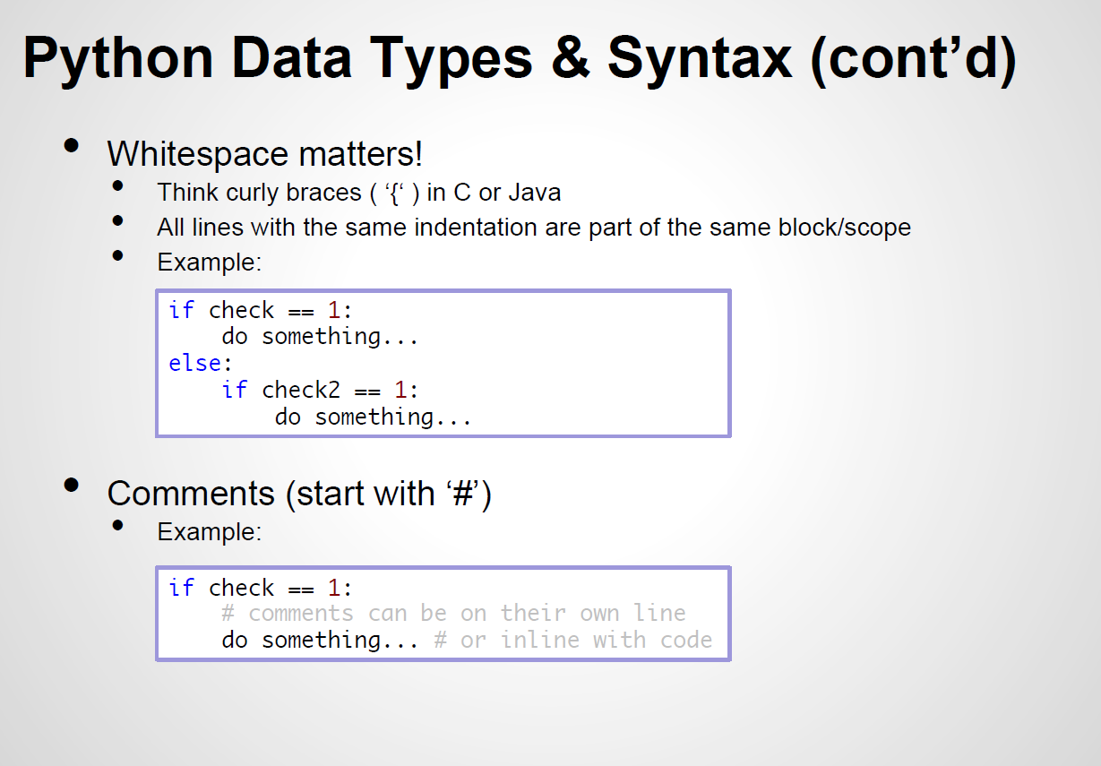
https://www2.cs.duke.edu/courses/fall14/compsci260/resources/python.tutorial.1.2014.pdf

Slide 9
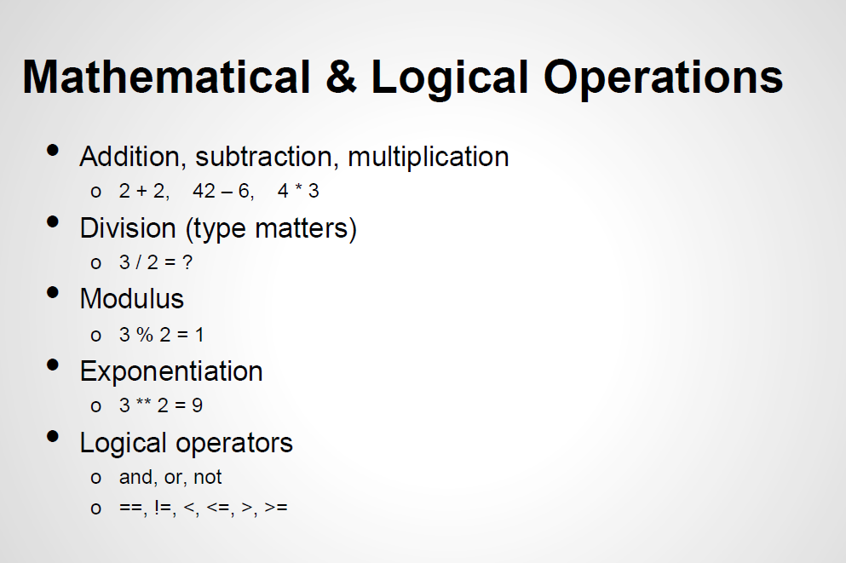
https://www2.cs.duke.edu/courses/fall14/compsci260/resources/python.tutorial.1.2014.pdf

Slide 10
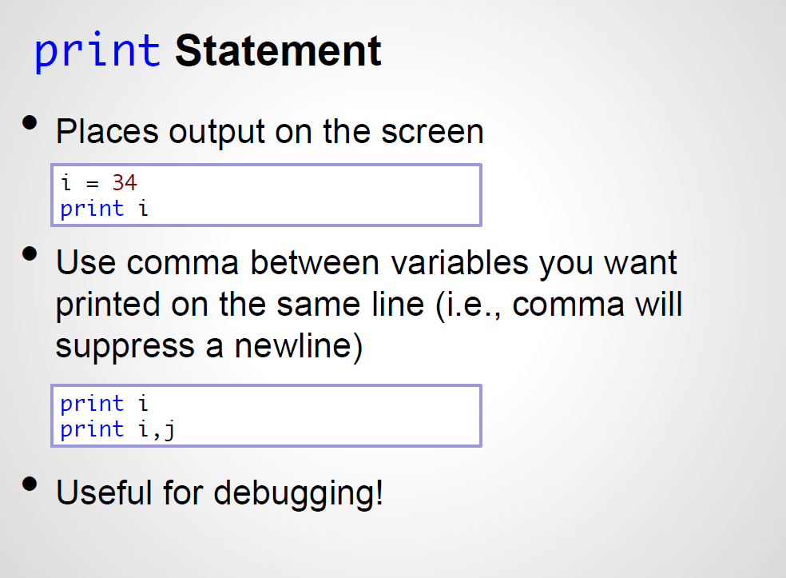
Python 2 ! Python 3?
https://www2.cs.duke.edu/courses/fall14/compsci260/resources/python.tutorial.1.2014.pdf

Slide 11
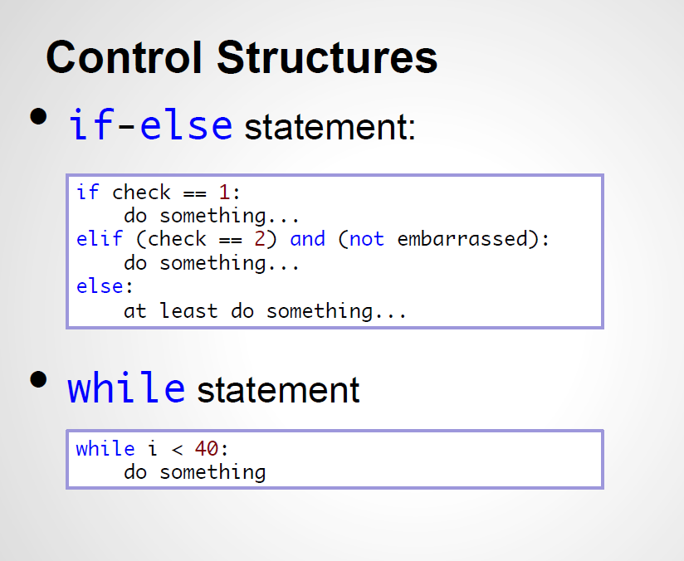
https://www2.cs.duke.edu/courses/fall14/compsci260/resources/python.tutorial.1.2014.pdf

Slide 12
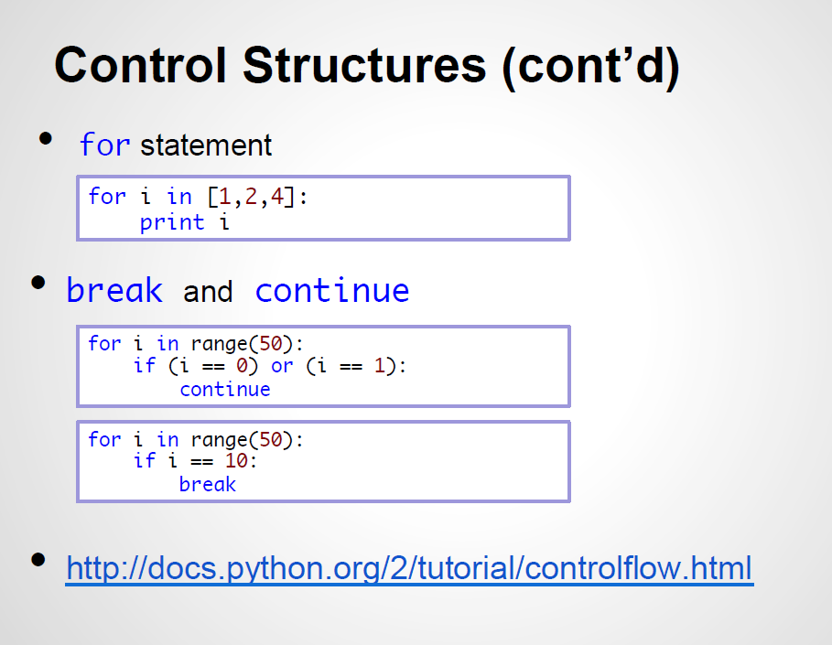
https://www2.cs.duke.edu/courses/fall14/compsci260/resources/python.tutorial.1.2014.pdf

Slide 13
Main Python Objects
Lists (mutable sets of strings)
var = [] # create list
var = [‘one’, 2, ‘three’, ‘banana’]
Strings …
Tuples (immutable sets)
var = (‘one’, 2, ‘three’, ‘banana’)
Dictionaries (associative arrays or ‘hashes’)
var = {} # create dictionary
var = {‘lat’: 40.20547, ‘lon’: -74.76322}
var[‘lat’] = 40.2054
Each has its own set of methods

Slide 14
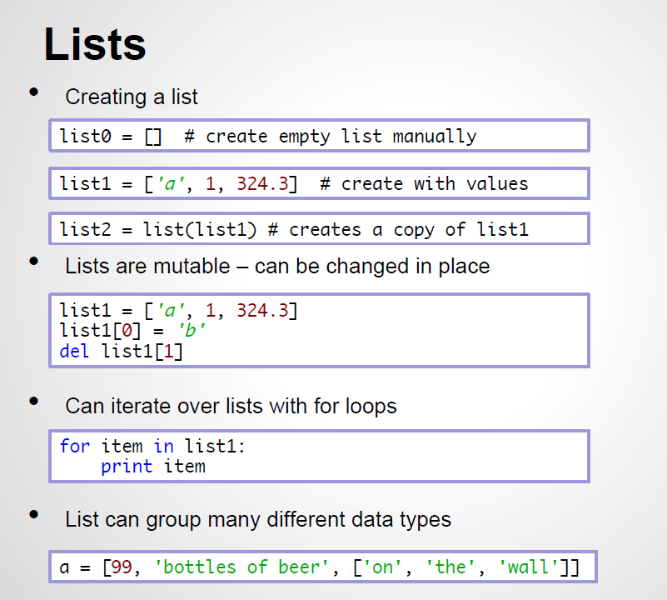
https://www2.cs.duke.edu/courses/fall14/compsci260/resources/python.tutorial.1.2014.pdf

Slide 15
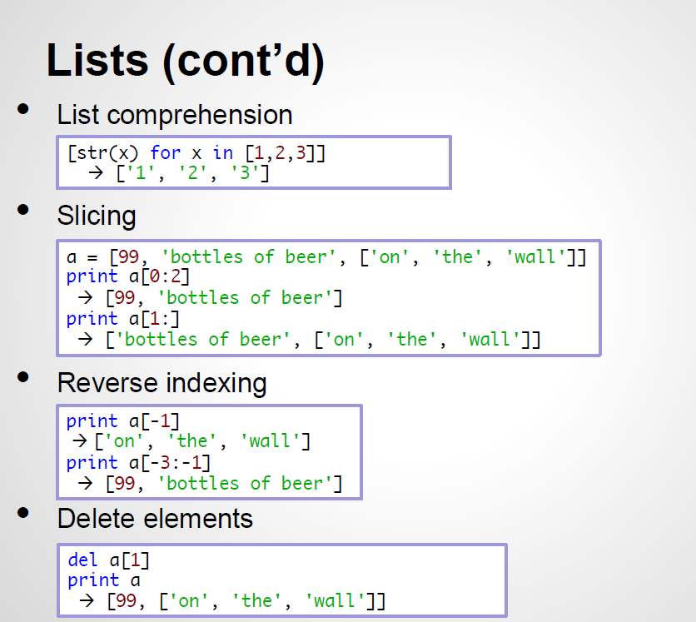
https://www2.cs.duke.edu/courses/fall14/compsci260/resources/python.tutorial.1.2014.pdf

Slide 16
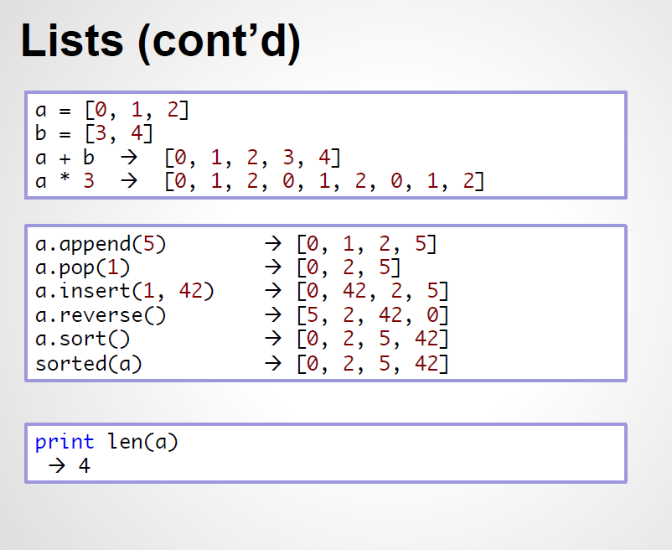
https://www2.cs.duke.edu/courses/fall14/compsci260/resources/python.tutorial.1.2014.pdf

Slide 17
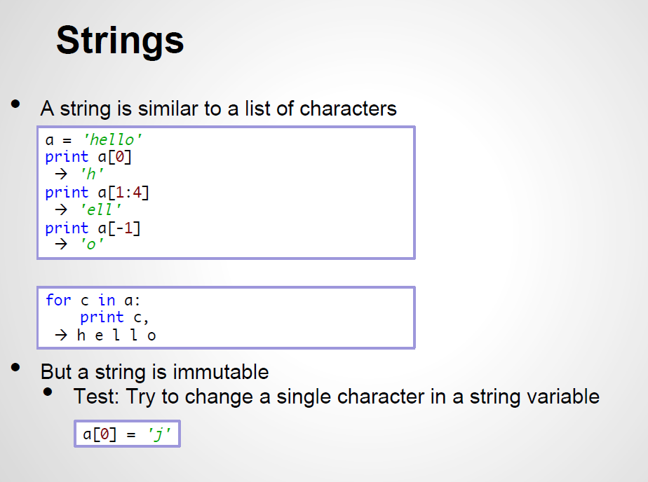
https://www2.cs.duke.edu/courses/fall14/compsci260/resources/python.tutorial.1.2014.pdf

Slide 18
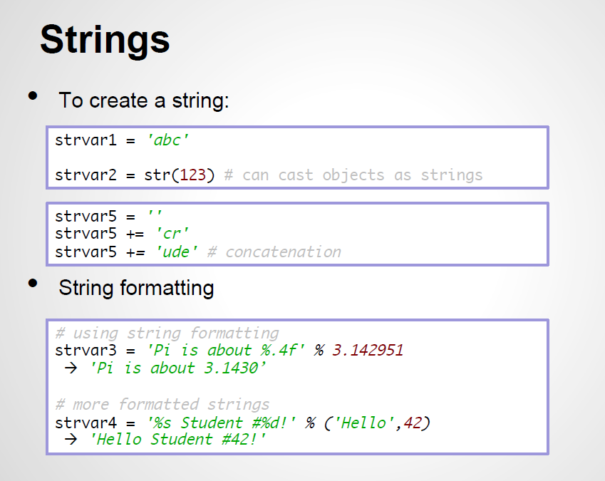
https://www2.cs.duke.edu/courses/fall14/compsci260/resources/python.tutorial.1.2014.pdf

Slide 19
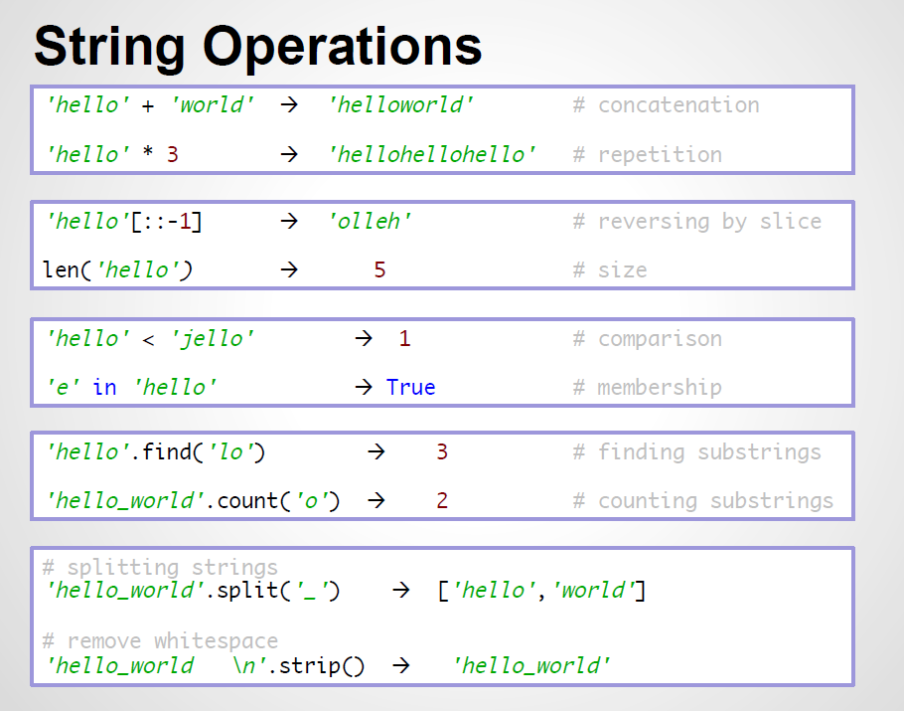
https://www2.cs.duke.edu/courses/fall14/compsci260/resources/python.tutorial.1.2014.pdf

Slide 20
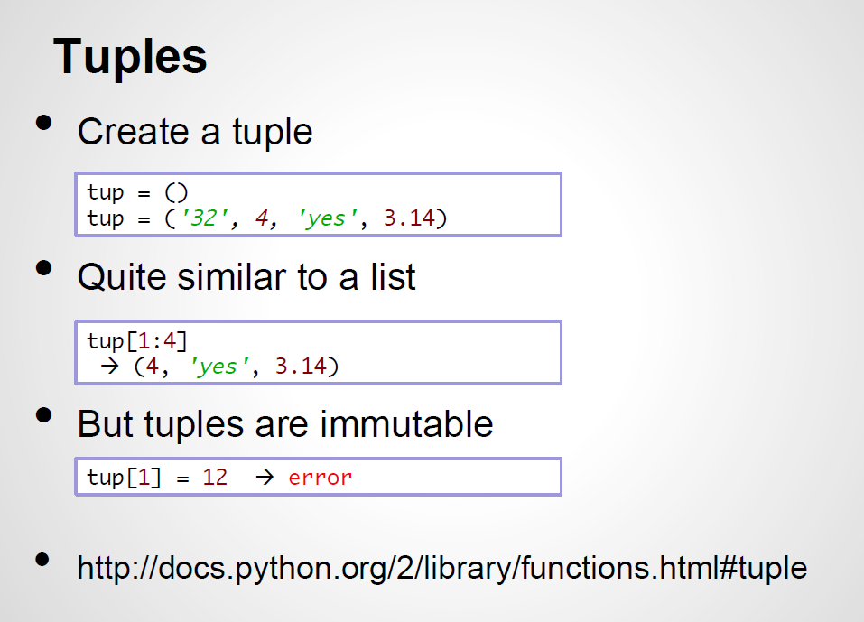
https://www2.cs.duke.edu/courses/fall14/compsci260/resources/python.tutorial.1.2014.pdf

Slide 21
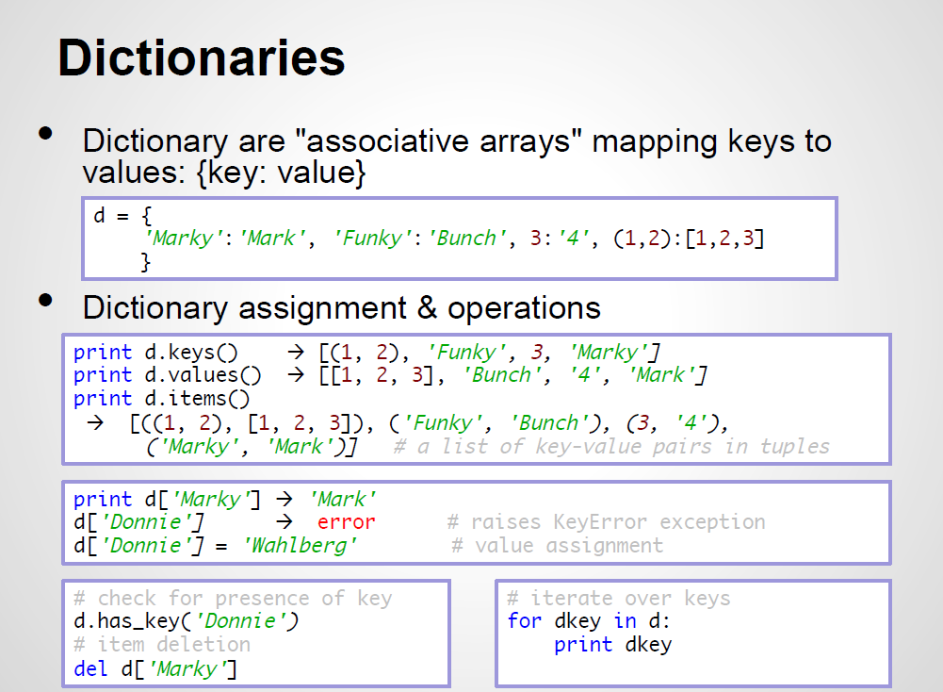
https://www2.cs.duke.edu/courses/fall14/compsci260/resources/python.tutorial.1.2014.pdf

Slide 22
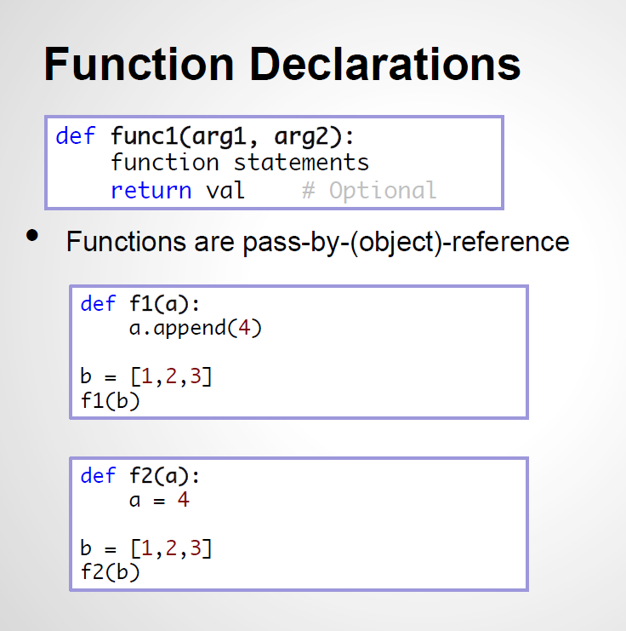
https://www2.cs.duke.edu/courses/fall14/compsci260/resources/python.tutorial.1.2014.pdf

Slide 23
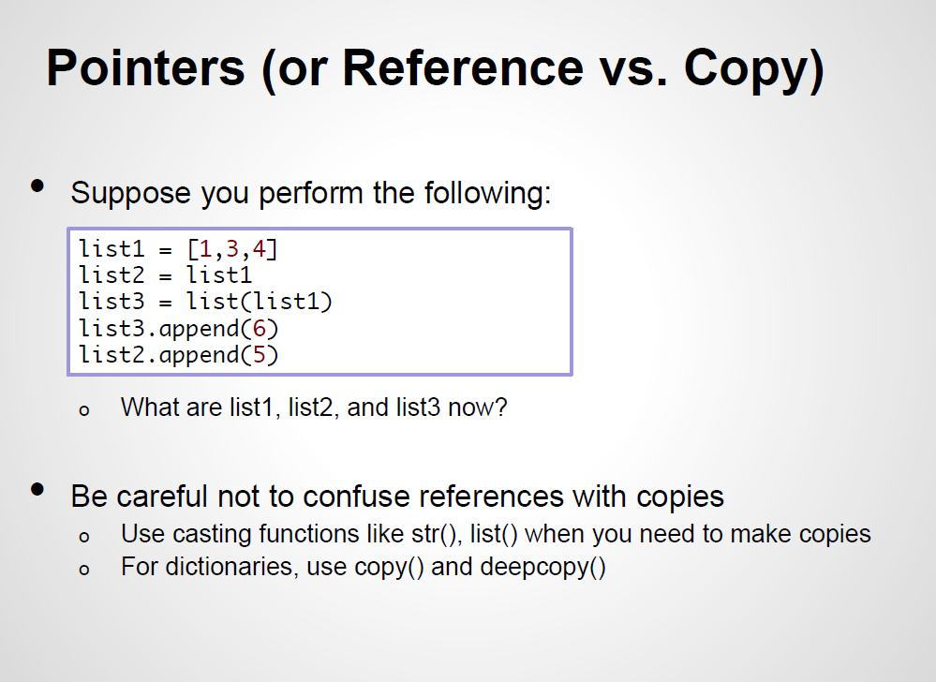
https://www2.cs.duke.edu/courses/fall14/compsci260/resources/python.tutorial.1.2014.pdf

Slide 24
Python Introduction
Using Command Line, Ipython, …
Using IDE : PyCharm, Spider, …
Using Notebooks

Slide 25
Python on command line
Write some Python code into a text file
Save it with .py suffix, say script.py
Open a terminal on your machine
Then type:
python script.py Arg1 Arg2 …

Slide 26
Python Introduction
Functions

Slide 27
Python Introduction
Methods (Functions that belong to Objects)

Slide 28
Python Introduction
Methods ( … )

Slide 29
Python Introduction: Packages
Packages ( … )

Slide 30
Python Introduction
PANDAS Data Frames
Python Data Analysis Library

Slide 31
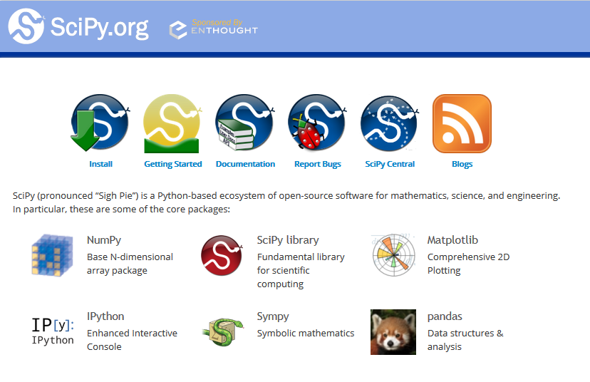

Slide 32
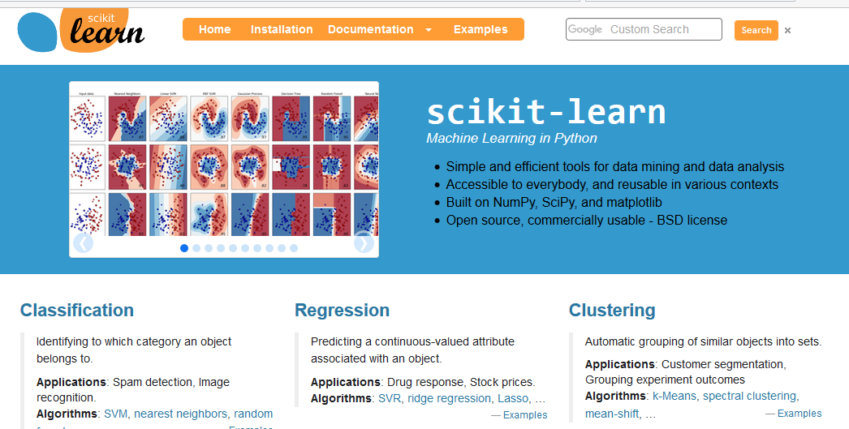

Slide 33
Python Introduction

Slide 34
Python Introduction

Slide 35
Python Introduction
Follow:
test_packages.py

Slide 36
Python Introduction

Slide 37
Python Introduction

Slide 38
Python Introduction

Slide 39
Python Introduction

Slide 40
Python Introduction

Slide 41
Python Introduction

Slide 42
Python Introduction

Slide 43
Python Introduction
Comment:
Reshape

Slide 44
Python Introduction

Slide 45
Python Introduction

Slide 46
Python Introduction

Slide 47
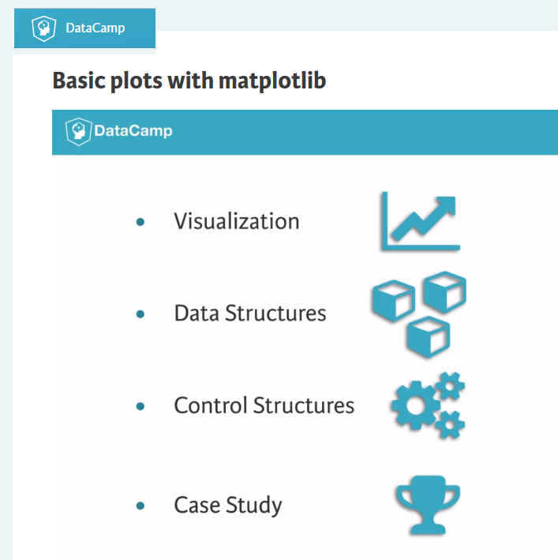
Python Introduction
Intermediate Python for Data Science

Slide 48
Python Introduction

Slide 49
Python Introduction

Slide 50
Python Introduction

Slide 51
Python Introduction

Slide 52
Python Introduction

Slide 53
Python Introduction
Dictionaries
Dataframes (pandas)
https://www.datacamp.com/community/tutorials/python-dictionary-tutorial#create_dictionary
https://campus.datacamp.com/courses/pandas-foundations/data-ingestion-inspection?ex=1

Slide 54
Python Introduction
https://www.datacamp.com/community/tutorials/python-dictionary-tutorial#create_dictionary
A special data structure which Python provides natively is the dictionary. Its name already gives away how data is stored:
a piece of data or values that can be accessed by a key(word) you have at hand.

Slide 55
Python Introduction
how to load data in your dictionary with the help of the urllib and random libraries
how to filter the dictionary with the help of a for-loop and special iterators to loop over the keys and values of your dictionary,
how to perform operations on your dictionary to get or remove values from your dictionary and how you can use dictionary comprehension to subset values from your dictionary,
how to create a dictionary by making use of curly brackets and colons,
how to sort a dictionary with the re library and how OrderedDict and lambda functions can come in handy when you’re doing this,
how Python dictionaries compare to lists, NumPy arrays and Pandas DataFrames.

Slide 56
Python Introduction
Dictionary Versus Python lists, NumPy Arrays and Pandas DataFrames
much of the dictionary functionality can be and is indeed replaced by Pandas, a Python Data Analysis Library
Pandas, however, also uses dictionaries (next to other advanced data structures such as the NumPy array) to store its data. As a result, it is a good idea to know how a dictionary works …
Even when using Pandas, it is sometimes recommended to still use Python dictionaries when the situation calls for it, for instance when values simply need to be mapped and you don’t need Pandas functionality for anything else.
Finally, Pandas contains functions to convert a dictionary to a Pandas DataFrame and vice versa and dataframes can contain dictionaries. Both are indeed very useful parts of the modern data scientist’s toolbox

Slide 57
Python Introduction
https://pandas.pydata.org/pandas-docs/stable/10min.html
10 Minutes to pandas

Slide 58
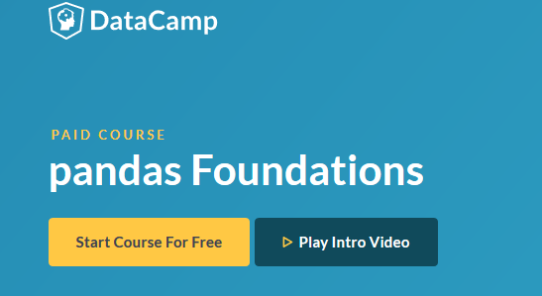
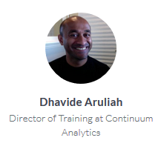
Python Introduction

Slide 59
Python Introduction

Slide 60
Python Introduction

Slide 61
Python Introduction
See how to get this data

Slide 62
Python Introduction
## HOW TO GET DATA
# http://pandas-datareader.readthedocs.io/en/latest/remote_data.html
## Functions from pandas_datareader.data and pandas_datareader.wb extract data
# from various Internet sources into a pandas DataFrame. Currently the following sources are supported:
Yahoo! Finance
Google Finance
Enigma
Quandl
St.Louis FED (FRED)
Kenneth French’s data library
World Bank
OECD
Eurostat
Thrift Savings Plan
Nasdaq Trader symbol definitions

Slide 63
Python Introduction

Slide 64
Python Introduction

Slide 65
Python Introduction

Slide 66
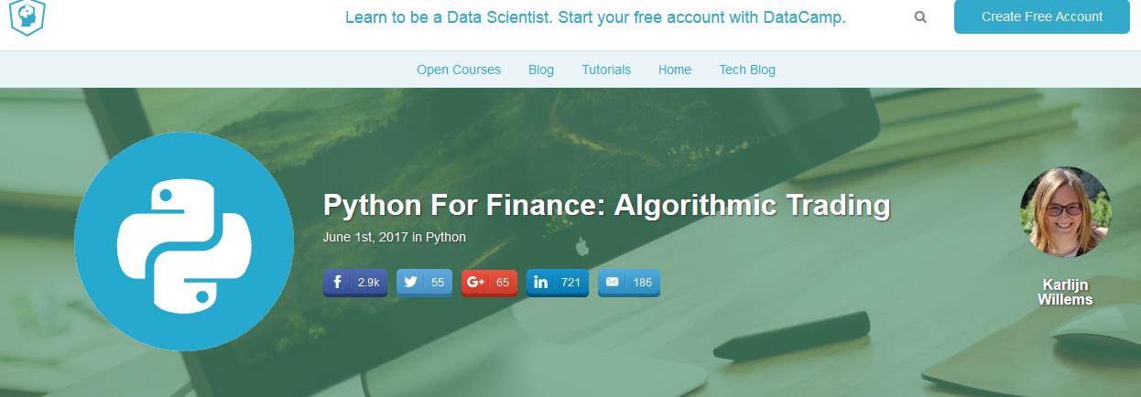
https://www.datacamp.com/community/tutorials/finance-python-trading#gs.1XmreoQ

Slide 67
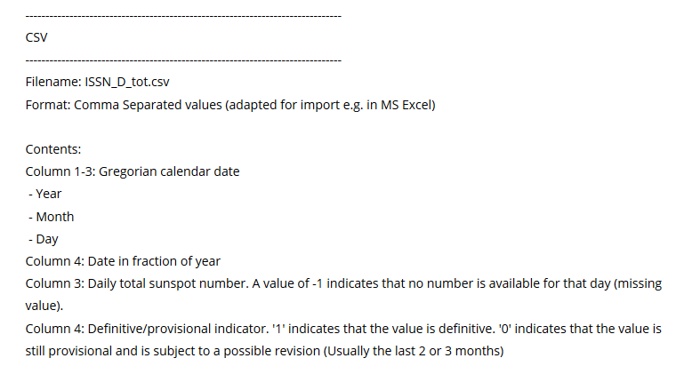
Python Introduction (Importing Data)
Daily total sunspot number
http://sidc.oma.be/silso/infossntotdaily

Slide 68
Python Introduction

Slide 69
Python Introduction

Slide 70
Python Introduction

Slide 71
Python Introduction

Slide 72
Python Introduction: Python for ecologists
http://www.datacarpentry.org/python-ecology-lesson/00-short-introduction-to-Python/
DATASETS:
https://figshare.com/articles/Portal_Project_Teaching_Database/1314459
For this lesson, we will be using the Portal Teaching data, a subset of the data from Ernst et al Long-term monitoring and experimental manipulation of a Chihuahuan Desert ecosystem near Portal, Arizona, USA
We will be using files from the Portal Project Teaching Database. This section will use the surveys.csv file that can be downloaded here: https://ndownloader.figshare.com/files/2292172
We are studying the species and weight of animals caught in plots in our study area. The dataset is stored as a .csv file: each row holds information for a single animal, and the columns represent:

Slide 73
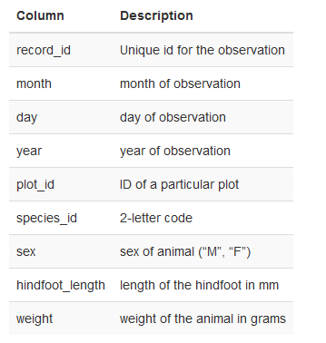
Python Introduction: Python for ecologists
DATASETS: surveys.csv
We are studying the species and weight of animals caught in plots in our study area.
The dataset is stored as a .csv file: each row holds information for a single animal, and the columns represent:

Slide 74
Python Introduction: Combining DataFrames with pandas
Data aggregation
In many “real world” situations, the data that we want to use come in multiple files.
We often need to combine these files into a single DataFrame to analyze the data. The pandas package provides various methods for combining DataFrames including merge and concat.
To work through the examples below, we first need to load the species and surveys files into pandas DataFrames.
test_aggregation.py

Slide 75
Python Introduction
Joining DataFrames
Another way to combine DataFrames is to use columns in each dataset that contain common values (a common unique id).
Combining DataFrames using a common field is called “joining
NOTE: This process of joining tables is similar to what we do with tables in an SQL database.

Slide 76
Python Introduction
species.csv contains the:
genus
species
taxa code for 55 species.
The species code is unique for each line. These species are identified in our survey data as well using the unique species code.
Rather than adding 3 more columns for the genus, species and taxa to each of the 35,549 line Survey data table, we can maintain the shorter table with the species information. When we want to access that information, we can create a query that joins the additional columns of information to the Survey data.
Storing data in this way has many benefits including:
It ensures consistency in the spelling of species attributes (genus, species and taxa) given each species is only entered once.
It also makes it easy for us to make changes to the species information once without having to find each instance of it in the larger survey data.
It optimizes the size of our data.

Slide 77
Test pandas
how many males have IAH > 30 values?

Slide 78
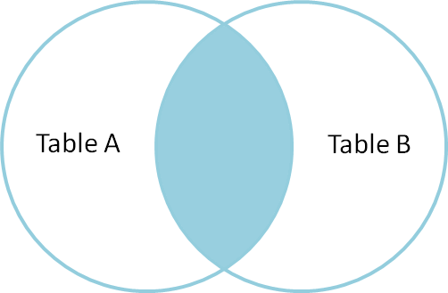
Python Introduction: type of joins
Inner join : merge
returns a new DataFrame that contains only those rows that have matching values in both of the original DataFrames.

Slide 79
Python Introduction: type of joins
Merge_df = pd.merge(left_df, right_df, on=‘column', how='inner')
Create an:
OSA_inner_df

Slide 80
Python Introduction: type of joins
Merge_df = pd.merge(left_df, right_df, on=‘column', how='inner')
Create an:
OSA_inner_df

Slide 81
Python Introduction: type of joins
OSA_inner_df = pd.merge(OSA_Clinical_df, OSA_Demo_df, on='ID', how='inner')
how many males have IAH > 30 values?

Slide 82
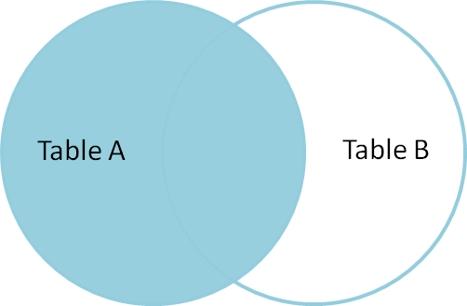
Python Introduction: type of joins
Left join : merge + how=‘left’
Return all of the rows from the left DataFrame, even those rows whose join key(s) do not have values in the right DataFrame.
Rows in the left DataFrame that are missing values for the join key(s) in the right DataFrame will simply have null (i.e., NaN or None)
Note: a left join will still discard rows from the right DataFrame that do not have values for the join key(s) in the left DataFrame.

Slide 83
Python Introduction
Other join types
The pandas merge function supports other join types:
Right (outer) join: Invoked by passing how='right' as an argument. Similar to a left join, except all rows from the right DataFrame are kept, while rows from the left DataFrame without matching join key(s) values are discarded.
.

Slide 84
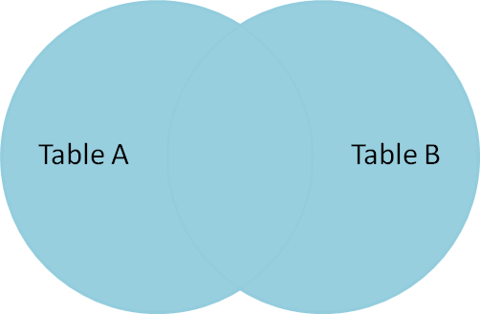
Python Introduction
Full (outer) join: Invoked by passing how='outer' as an argument. This join type returns the all pairwise combinations of rows from both DataFrames; i.e., the result DataFrame will NaN where data is missing in one of the dataframes. This join type is very rarely used.

Slide 85
Python Introduction: for loops
See examples in web, an in particular look for
“processing directories…”

Slide 86
Python Introduction: ggplot
The ggplot package, which facilitates the creation of highly-informative plots of structured data based on the R implementation of ggplot2 and The Grammar of Graphics by Leland Wilkinson.
test_ggplot.py (… TBD)

